Slide 1


Bringing your professional voice to the Microsoft table
How to build confidence
Microsoft Virtual Internship Platform

Slide 2
Introduction to this Model Answer
This Model Answer is designed to illustrate a complete professional presentation on this topic.
You were not asked to provide this level of detail. We hope you see the content of your answer represented throughout the presentation.
It has been designed to provide you with more guidance and helpful information to apply in the workplace.

Slide 3

What is confidence?
Why is it important to demonstrate it at work?

Slide 4
What is confidence?
Comes from a latin word ‘fidere' which means ‘to trust’; therefore, having self-confidence is having trust in one's self.
It is a belief in oneself, the conviction that one has the ability to meet life's challenges and to succeed—and the willingness to act accordingly.
Essentially, it is knowing what you’re good at, the value you provide, and acting in a way
that conveys that
to those around you.

Slide 5
Projecting confidence in the workplace enables you to:
Gain credibility
Make a strong first impression
Deal with pressure
Tackle personal and professional challenges
Put others at ease
Be taken more seriously if your words and action have conviction
Experience more as you’re more likely to engage in challenging, but manageable projects
Push the boundary of your comfort zone and increase your performance
Communicate more effectively, as confidence allows you to speak concisely and with clarity.
Projecting confidence contributes to professionalism which is helpful for your advancing job and career.

Slide 6
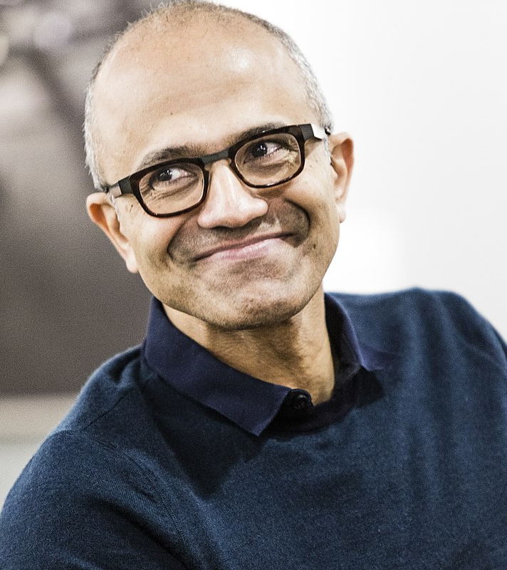
What are the key characteristics of someone who demonstrates confidence?

Slide 7
I chose Satya Nadella as the person who demonstrates confidence because he…
Believes in himself and his ideas
Obtains his happiness from within
Is grateful
Exercises to help focus the mind and keep fit
Is always positive
Is very prepared for everything
Never gives up
Speaks with certainty
Takes risks
Isn’t afraid to be wrong
Applauds other people
Listens more than he speaks
Is modest
Isn’t afraid to ask for help
Dedicates time to what matters
Communicates clearly and passionately

Slide 8
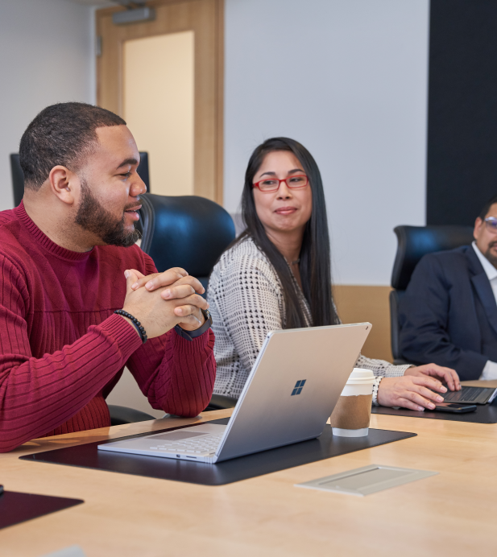
How to demonstrate confidence and bring your voice to the table.

Slide 9
Start by building confidence through:
Identifying strengths and capitalizing on them
Identifying weaknesses and working on them
Identifying what is most important to you
Undertaking activities that develop mental and physical energy
Believing in yourself
Replacing negative self-talk with positive inner dialogue
Asking for help and guidance
Observing the behaviours of confident people around you and learning from them
Seeking feedback and being open to constructive criticism
Seeking encouragement from others
Praising yourself
Adopting an optimistic attitude
Committing to being more courageous
Standing tall, being proud and enjoying what you do

Slide 10
Then practice demonstrating more confidence by:
Being aware of how you hold yourself and the signals your body language is giving out
Being clear on your views
Being well prepared
Being genuine, open and warm
Being authentic
Starting communication with a strong, confident ‘I’ statement
Warmly acknowledging the other’s persons point of view when confronted or questioned
Expecting to be challenged at times and showing conviction in your ideas
Using evidence and research to support your views
Encouraging innovative and critical thinking to achieve a better outcome
Celebrating your successes and telling others about them
Practising your skills. Speaking up is a skill and practicing ahead of time with trusted friends or colleagues will build your competence and confidence.
Sharing your ideas with a trusted colleague or two and asking them if you should share your idea with the larger group. This allows you to find an advocate for the idea before you even bring it up with others which will help build your confidence.

Slide 11
Then confidently bring your voice to the Microsoft table by:
Expressing what you are passionate about so it inspires and motivates others
Using confident and assertive language. Avoid phrases such as ‘sorry for raising this’, ‘I’m not sure’ and ‘this may not be important’.
Being clear, concise and impactful
Displaying positive body language at all times
Being adequately prepared to enhance your credibility and demonstrate importance of the topic to you
Identifying as many opportunities as possible to share your ideas, views and questions
Believing that your voice is valuable and the organisation wants to hear it.

Slide 12
At Microsoft we want to hear your voice.
© Copyright Microsoft Corporation. All rights reserved.

